Slide 1

Process Management
Soumya Sahoo
Assistant Professor, CSE
C.V Raman Global University, Bhubaneswar
CGU,OS,

Slide 2
Processes: outline
Basic concepts
Process states and structures
Process management
Specific implementations
Soumya Sahoo,Asst.Prof,CGU

Slide 3
Main OS Process-related Goals
Interleave the execution of existing processes to maximize processor utilization.
Provide reasonable response times.
Allocate resources to processes.
Support inter-process communication (and synchronization) and user creation of processes
Soumya Sahoo,Asst.Prof,CGU

Slide 4
How are these goals achieved?
Schedule and dispatch processes for execution by the processor.
Implement a safe and fair policy for resource
allocation to processes .
Respond to requests by user programs.
Construct and maintain tables for each process managed by the operating system.
Soumya Sahoo,Asst.Prof,CGU

Slide 5
Process
3
A process needs certain resources such as:
  CPU Time
  Memory Files
  I/O Devices
to accomplish its task.
These resources are allocated to the process either when it is created or while it is executing.
S.Sahoo,CGU
CSE

Slide 6
Process Contd..
A process is a set of sequential steps that are required to do a particular task.
A process is an instance of a program in execution
Soumya Sahoo,Asst.Prof,CGU

Slide 7
Process States
4
A process goes through a series of process states for performing its task.
As a process executes, it changes state.
Various events can cause a process to change state.
S.Sahoo,CGU
CSE

Slide 8
Process States
6
New:
  A process that has just been created.
Ready:
  The process is ready to be executed.
Running:
  The process whose instructions are being executed is called running process.
S.Sahoo,CGU
CSE

Slide 9
Process States
7
Waiting:
  The process is waiting for some event to occur such
as completion of I/O operation.
Terminated:
  The process has finished its execution.
Note: Only one process can be running on any processor at any instant. However, there can be many processes in ready and waiting states.
S.Sahoo,CGU
CSE

Slide 10
Process State Transitions
When do these transitions occur?
Running
1. Process blocks for input or waits for an event
2. End of time-slice, or preemption
3. Scheduler switches back to this process
4. Input becomes available, event arrives
1
2
3
Blocked
Ready
4
Soumya Sahoo,Asst.Prof,CGU

Slide 11
Five-State Process Model
Dispatch
Release
Admit
New
Ready
Running
Exit
Time-out
Event
Occurs
Event
Wait
Blocked
Soumya Sahoo,Asst.Prof,CGU

Slide 12
Process State Transition Diagram with Two Suspend States
New
Admit
Suspend
Admit
Activate
Dispatch
Ready,
suspend
Ready
Running
Exit
Suspend
Time out
Event
Occurs
Event
Wait
Event
Occurs
Activate
Blocked,
suspend
Blocked
Suspend
Soumya Sahoo,Asst.Prof,CGU

Slide 13
Process Control Block (PCB)
8
Process Control Block (PCB) is a data structure used by operating system to store all the information about a process.
It is also known as Process Descriptor.
When a process is created, the operating system creates a corresponding PCB.
S.Sahoo,CGU

Slide 14
Process Control Block (PCB)
9
Information in a PCB is updated during the transition of process states.
When a process terminates, its PCB is released.
Each process has a single PCB.
S.Sahoo,CGU
CSE

Slide 15
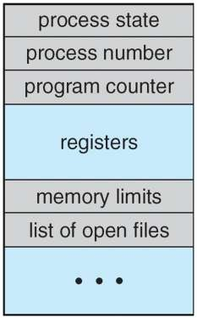
Process Control Block (PCB)
10
The PCB of a process contains the following information:
S.Sahoo,CGU
CSE

Slide 16
Process Control Block (PCB)
11
Process Number: Each process is allocated a unique number for the purpose of identification.
Process State: It specifies the current state of a process.
Program Counter: It indicates the address of next instruction to be executed.
S.Sahoo,CGU
CSE

Slide 17
Process Control Block (PCB)
12
Registers: These hold the data or result of calculations. The content of these registers is saved so that a process can be resumed correctly later on.
Memory Limits: It stores the amount of memory units allocated to a process.
List of Open Files: It stores the list of open files and there access rights.
S.Sahoo,CGU
CSE

Slide 18
Scheduling Queues
In multiprogramming, several processes are there in ready or waiting state.
These processes form a queue.
The various queues maintained by operating system are:
  Job Queue
  Ready Queue
  Device Queue
S.Sahoo,CGU
CSE

Slide 19
Scheduling Queues
17
Job Queue:
  As the process enter the system, it is put into a job queue. This queue consists of all processes in the system.
Ready Queue:
  It is a doubly linked list of processes that are residing in the main memory and are ready to run.
CSE
S.Sahoo,CGU

Slide 20
Scheduling Queues
18
Device Queue:
  It contains all those processes that are waiting for a particular I/O device.
  Each device has its own device queue.
Diagram on the next slide shows the queues.
S.Sahoo,CGU
CSE

Slide 21
Dispatcher
15
Dispatching: Setting up the execution of the selected process on the CPU is called dispatching.
  It is done by a component of operating system called
Dispatcher.
  Thus, a dispatcher is a program responsible for assigning the CPU to the process, that has been selected by the Scheduler.
Context Save: Saving the status of a running process when its execution is to be suspended is known as context save.
S.Sahoo,CGU
CSE

Slide 22

Scheduling: Single Blocked Queue
Ready Queue
Dispatch
Release
Admit
Processor
Time-out
Event Wait
Event
Occurs
Blocked Queue
Soumya Sahoo,Asst.Prof,CGU

Slide 23

Scheduling: Multiple Blocked Queues
Ready Queue
Dispatch
Release
Admit
Processor
Time-out
Event 1
Occurs
Event 1 Wait
Event 1 Queue
Event 2
Occurs
Event 2 Wait
Event 2 Queue
Soumya Sahoo,Asst.Prof,CGU

Slide 24
Suspended Processes
Processor is much faster than I/O so many processes could be waiting for I/O
Swap some of these processes to disk to free up more memory
Blocked state becomes blocked-suspended state when swapped to disk, ready becomes
ready-suspended
Two new states
  Blocked-suspended
  Ready-suspended
Soumya Sahoo,Asst.Prof,CGU

Slide 25
Context Switch
20
Switching the CPU from one process to another process requires saving the state of old process and loading the saved state of new process.
This task is known as Context Switch.
When context switch occurs, operating system saves the context of old process in its PCB and loads the saved context of the new process.
S.Sahoo,CGU
CSE

Slide 26
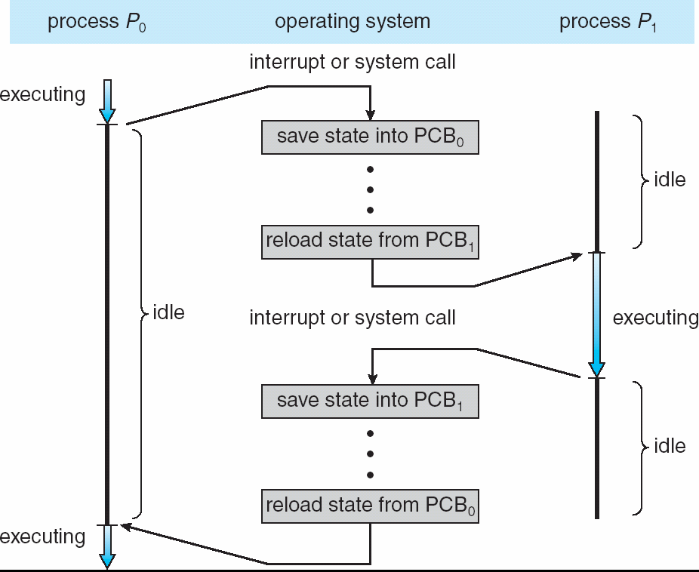
Context Switch
21
Switching of one process to another
S.Sahoo,CGU
CSE

Slide 27
Process Management Operations
Process creation and termination
Process scheduling and dispatching
Process switching
Process synchronization and support for inter-process communication
The OS maintains process data in the
Process Control Blocks (PCB)
Soumya Sahoo,Asst.Prof,CGU

Slide 28
Managing Processes (Unix)
pid = fork() - create a child process
wait(status) / waitpid(pid, status, opts) - wait for termination of a child. Either blocks, gets child return-code, or exit code (if no children)
execvp(name, args) – replace image by name, with arguments args
exit(status)
Soumya Sahoo,Asst.Prof,CGU

Slide 29
The Unix Process
fork system call:
  memory address space is “copied”
  parent receives pid of child (value of fork())
  child gets 0 (value of fork())
pid = fork(); /* upon success of fork() pid > 0 in parent */
if (pid < 0) { /* fork failed - memory full ... table full */
} else if (pid > 0) { /* Parent code goes here ... */
} else { /* Child code goes here ... */
}
* to find own pid - getpid()
Soumya Sahoo,Asst.Prof,CGU

